Slide 1
AN OVERVIEW: THE ADVANCED COURSE ACCREDITATION PROCESS
For: Florida Building Commission
April 13, 2021

Slide 2
EDUCATION ADMINISTRATOR HISTORY & ROLE
Worked in the construction business for 10 years
Have been the FBC Education Administrator for 16 years
Have worked in the Education/Training/Consulting business for 36 years
Role… (Regarding the Accreditation Process)
Coordinate activities between providers and accreditors, create ED POC Agenda, conduct administrative (not subject matter) reviews of all courses
Ensure all materials are included and make sense
Ensure all dates & code versions are current, through all materials
Ensure the syllabus is correct, according to 61G20-6.002 (4) (a) through (m)
Ensure no errors exist (e.g., spelling, grammatical, incorrect references, etc.)
Ensure all tables, graphs, figures are correctly titled and match verbiage
Randomly check code references to make sure correct and current

Slide 3
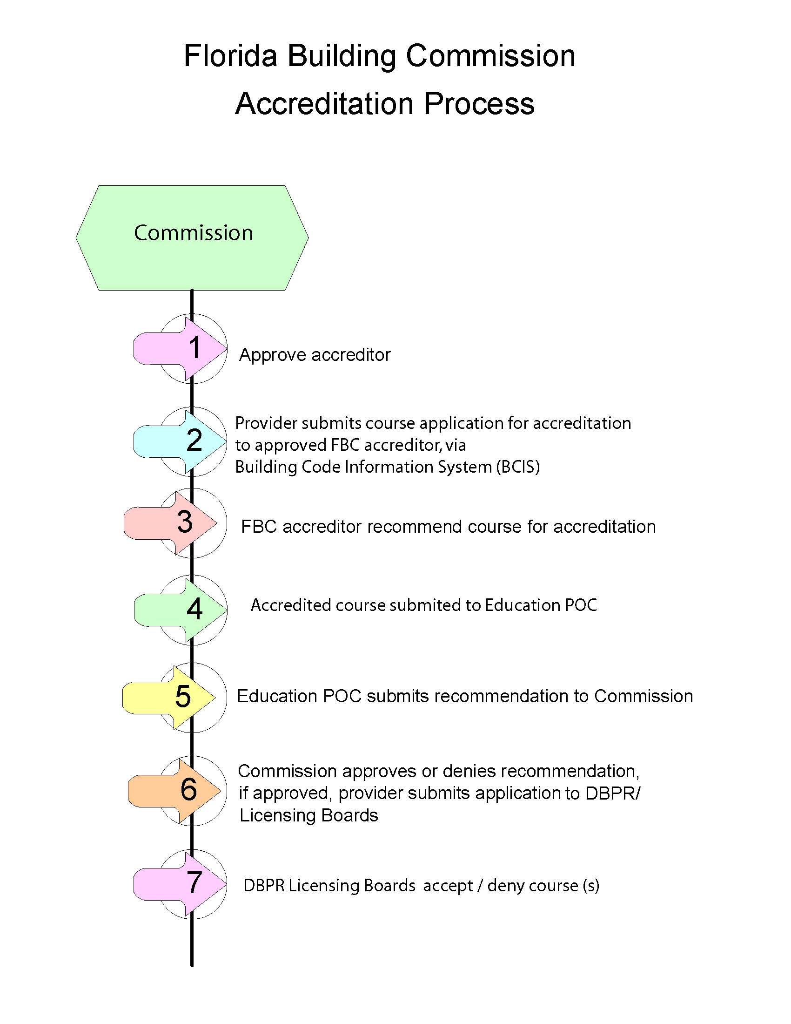
DEPICTION OF THE COURSE ACCREDITATION PROCESS

Slide 4
WHAT DOES AN ADVANCED COURSE APPLICATION CONSIST OF?
Described in Rule 61G20-6.002, (4) (a) through (m)
Syllabus
Course description, learning objectives, course outline, course timeline
Trainer materials (e.g., lecture notes, script, etc.)
Participant materials (e.g., PowerPoints, handouts, manuals, tests, etc.)
Method of course evaluation (stated in syllabus)

Slide 5
ADVANCED COURSE DEVELOPMENT CONSIDERATIONS
At least 50% of course content must be directly related to current version of the building code
Course itself must be developed using the current version of Fla. Building Code (7th edition)
Course materials must be converted to PDF format to be uploaded into BCIS
Must be checked for building code content accuracy and currency through the accreditation process
Must be technical in nature and relate directly to the design and building construction industries

Slide 6
HOW A PROVIDER WORKS WITH AN ACCREDITOR
When course is uploaded into BCIS, and accreditor is chosen, the accreditor will be notified via the BCIS
Accreditors are considered private entities (approved by the FBC) and will explain the process to the provider and identify their fee
Average review time for a one-hour course is 3-5 workdays
Accreditors may have to contact providers with questions and requested revisions
Accreditor will complete the course application with comments (if needed)
Both accreditor and provider will receive email notice generated by BCIS after course is accredited

Slide 7
ACCREDITOR REVIEW OF MATERIALS
To determine if code content (e.g., references, tables, graphs, pictures, numbers, verbiage, etc.) is accurate (Most Important)
To determine if at least 50% of content is directly related to the current code
To determine if course description describes course materials
To determine if objectives met through the materials
To determine if course outline/timeline reasonable – given the course topics
To determine if the course materials are complete, based on the FBC Rule 61G20-6.002 language of what is identified as part of the course (e.g., such as a test noted in the syllabus for an online course)

Slide 8
STEPS FOR THE ADVANCED COURSE (AC) ACCREDITATION PROCESS
AC is uploaded into the BCIS
AC is reviewed by the accreditor (chosen when submitting and uploading materials into the BCIS)
AC is accredited (according to building code content accuracy and currency with the latest version of the code)
Accredited AC is reviewed and approved (or not) by the FBC ED POC
Accredited AC is reviewed and approved by FBC at the Plenary Session
Approved AC moved to approved status in the BCIS
BCIS will generate an email and send to provider verifying a course’s approved status
Accredited/approved AC is submitted by provider to appropriate professional board at DBPR

